Slide 1




Studio Shodwe
HORSE SHOE PREDICTION
NEURAL NETWORK
Presented by: Zakaria Boutarfa
P2855274

Slide 2

Overview
  Conception
  Methodology
  Manipulating Data
  Visualization
  Architecture
  Training
  Results
  Optimization
  Conclusion

Slide 3


Conception
  Building a neural network to predict horse shoe’s external length based on four measurement of the horse shoe
  Developping an accurate performant and reliable model with optimized topology and appropriate visualization tools.

Slide 4
Data Manipulation
Transforming data
Splitting Datasets
  Arrange input to be in a range from 0 to 1 falicitate the training.
  Using transposed matrix
70% for training
20% for validation
10% for testing

Slide 5
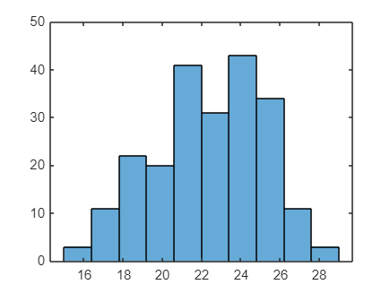
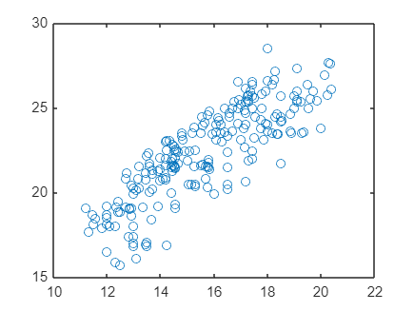
Visualization
Input Histogram
Input Plot

Slide 6

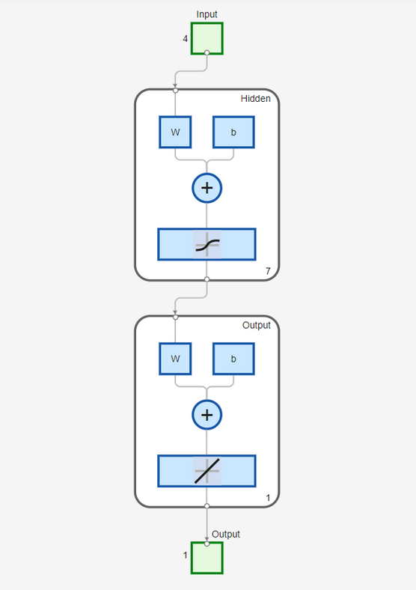

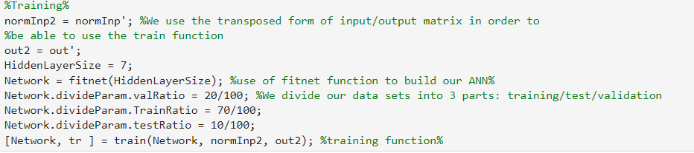
Architecture

Slide 7
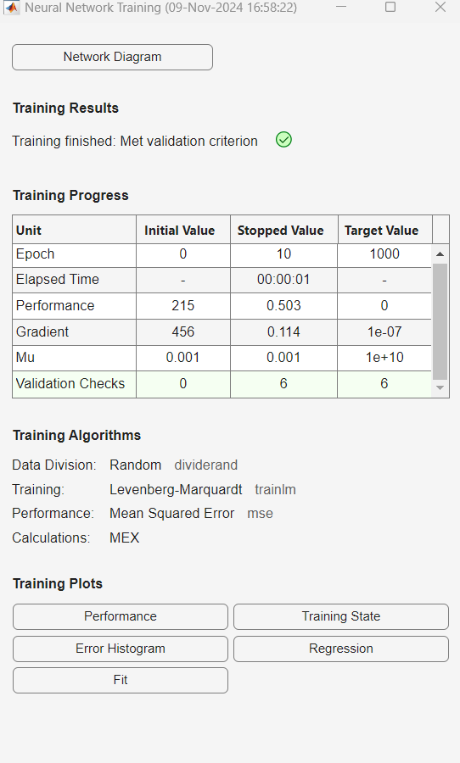
Training

Slide 8
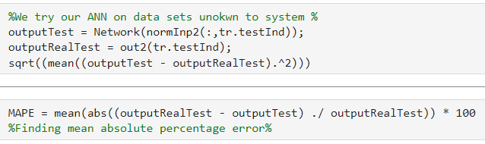

Results

Slide 9
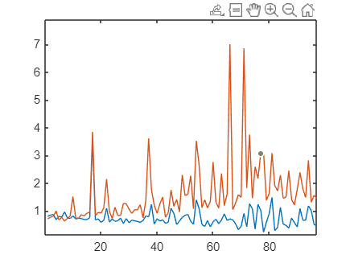
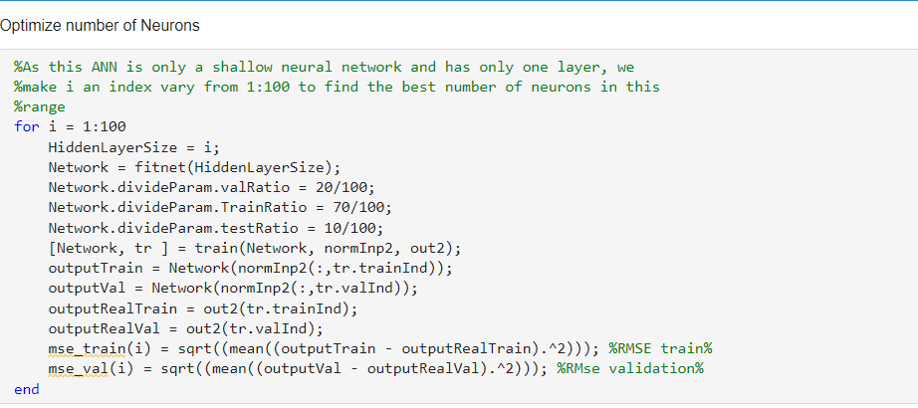
Optimization

Slide 10

Conclusion

Slide 11
THANK YOU
For watching this presentation

